Slide 1
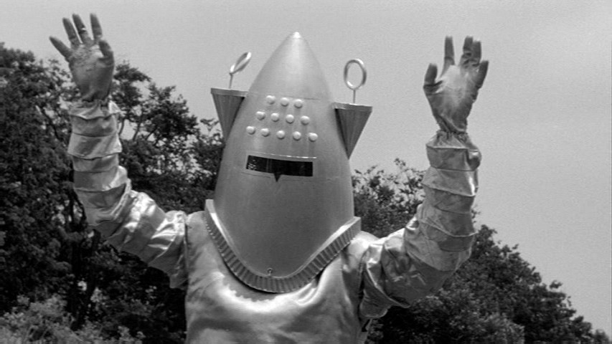
Detecting Exoplanets with Artificial Neural Networks
By:
Zach Green

Slide 2
Goal:
Train a neural network to detect exoplanet transits using the brightness of stars.
Answer the question:
How would the model perform on all the stars you can see in the sky?
Obstacles:
Weird things in space create false signals:
Binary stars
Sunspots
Cosmic dust clouds
A planetary transit occurs when a planet passes directly between its star and our viewpoint.

Slide 3
Kepler Spacecraft
Kepler was built to estimate the frequency of earthlike planets in the Milky Way.
Relevant data:
Corrected flux magnitude.
Measurements 30m apart.
Campaign 4 data:
Objects 3,000 light years away.
Milky way diameter is 150,000 ly.

Slide 4
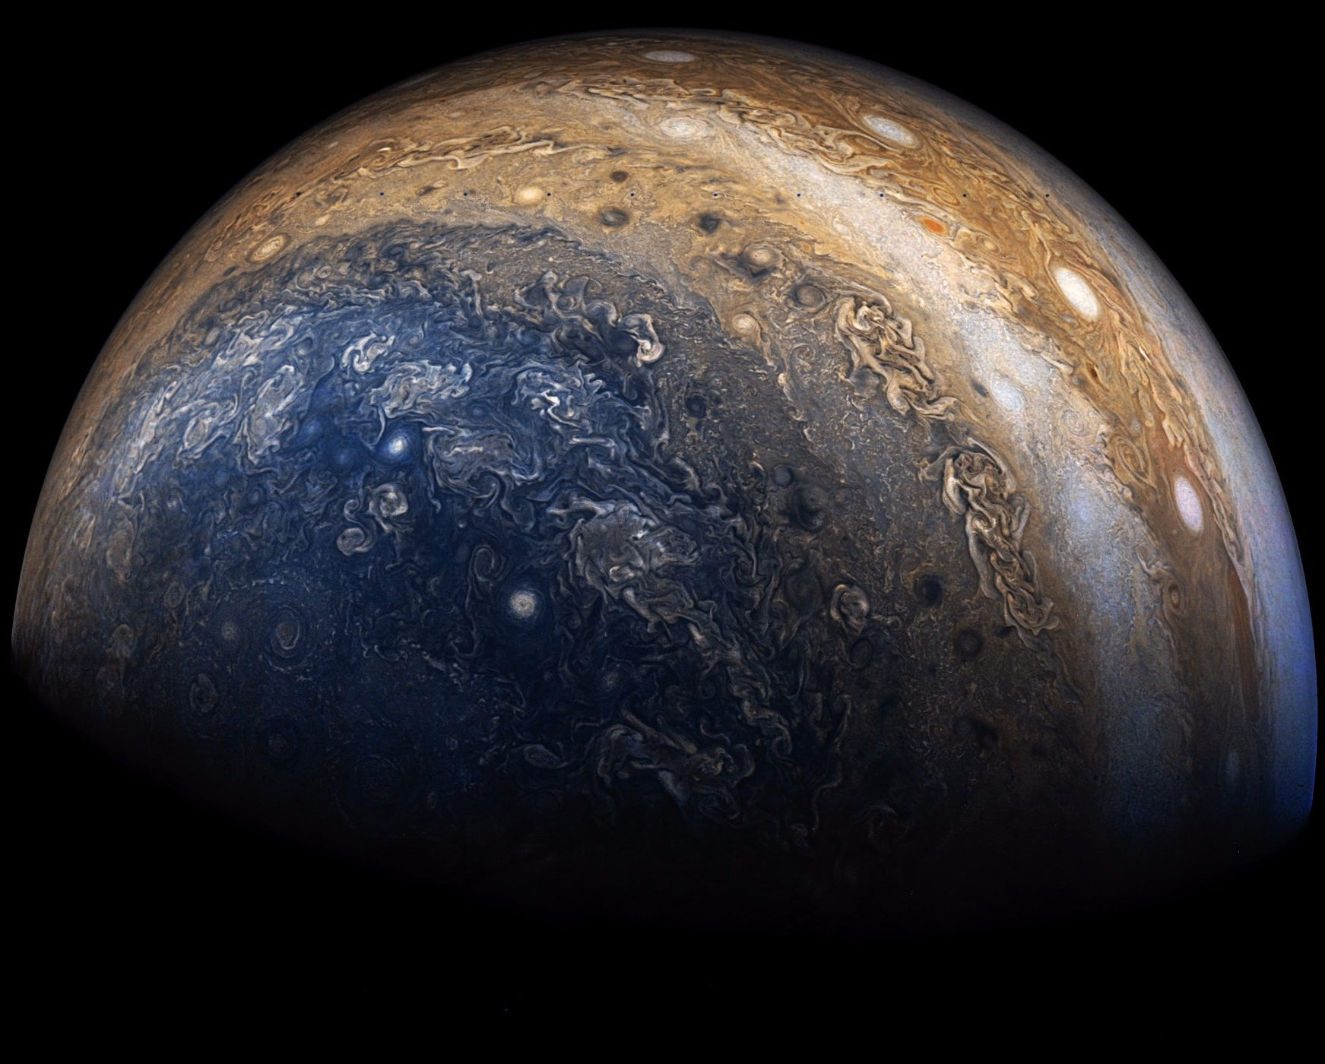
Getting the Data
It could take weeks to download all of available data.
250gb downloaded from NASA’s API with Wget scripts.
Sifted through files for corrected flux light curves.
Data in .fits files filled with spacecraft recordings.
Randomized planet light curves across timeframes.
This controls for confounding variables.

Slide 5
Lost in a Galaxy of Data

Slide 6
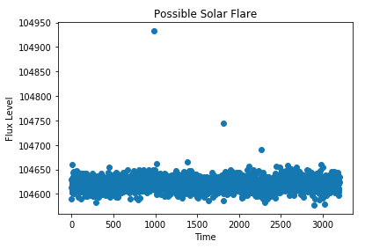
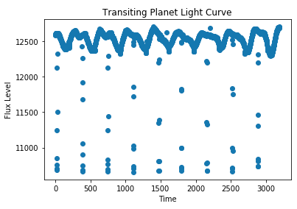
Exploring and Cleaning Data
Solar flares are common.
Our sun has between one a week and several a day.
Most transits occur over a few hours.
Orbital period can be calculated from the frequency of transits.
Cleaning missing values.
Longer periods of missing data were filled by skipping to the next non-null value.
Isolated missing points calculated from two adjacent points.

Slide 7
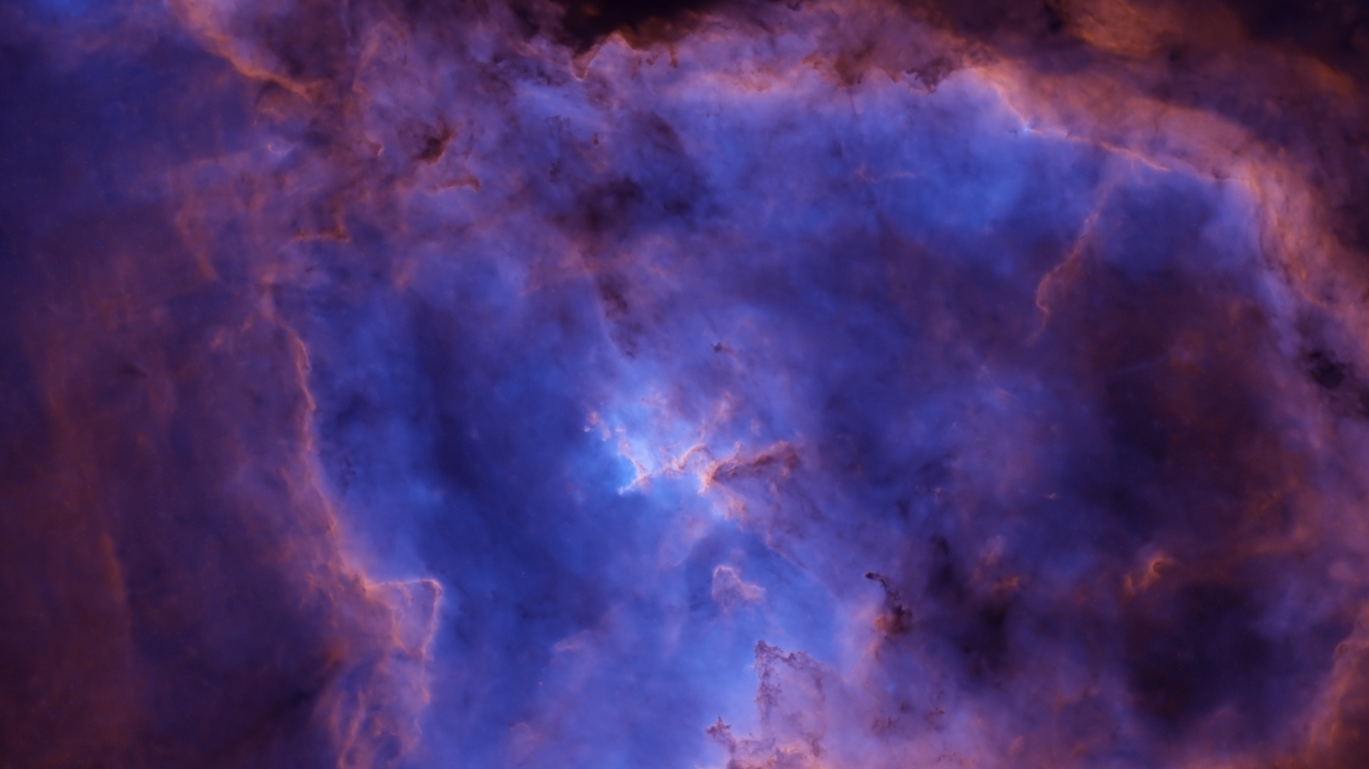
Preprocessing:
Scaled data to compare stars of different brightness.
Normalized scaling preserves ”unusual” events.
Mixed in 1100 confirmed planets to the training data.
This gives the neural network more to learn from.
Reduced time scale to 66 days to compare data from different sources.

Slide 8
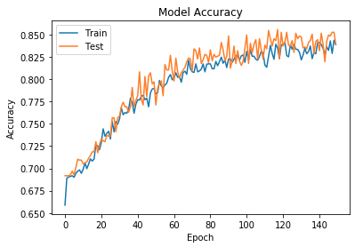
Neural Network
Convolutional Neural Network.
Looks over the light curve and learns what transits look like.
Often used in pattern and image recognition problems.
Topology:
3 convolutional & pooling layers.
Increasing dropout regularization
2 hidden layers.
High dropout regularization
This shows the model “learning” over time.

Slide 9
Results:
How many stars in the night sky have transits?
40 true planets.
Model predicted 98 planets.
12 of them actual planets. (30% of all true planets)
Performance
85% accuracy on training holdout.
Baseline 31%.
Up to 15 times better than chance on unseen data.
Limitations:
Can only make conclusions within campaign 4 sample.
High false positive rate.
Excludes some stars with planets.

Slide 10
What we Really Want to Know:
Are there aliens?
Did they make the pyramids?
How many earth-like planets in habitable zone?
40 billion in the Milky Way.
100 billion total planets.
Typical planet size:
Between the size of Earth and Jupiter.
Typical orbital period:
Most are less than 100 days.

Slide 11
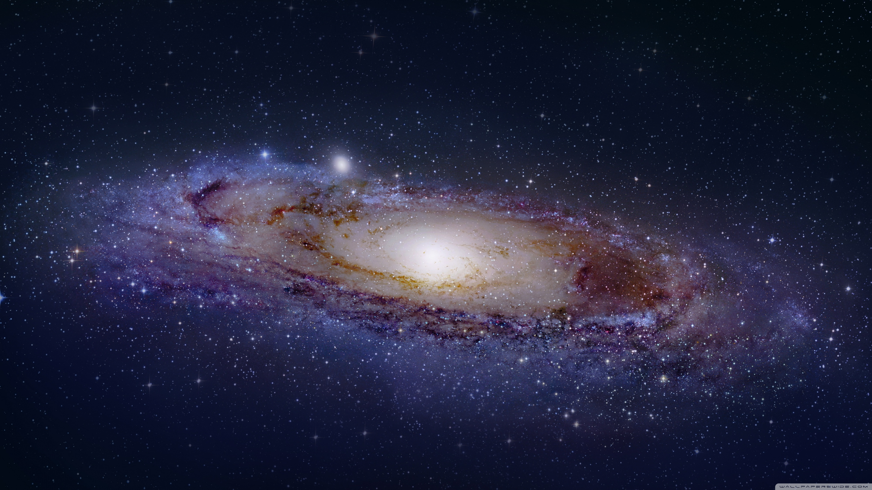
Directions for Further Study:
Validate with data from other telescopes.
Randomize data sources.
What other things can be found with this data?
Try applying clustering.
Can we detect Dyson spheres?
Exomoons?
Bring in information about candidate planets.
Compare other methods of planet detection.

Slide 12
Questions?

